Slide 1
CIS 484 Final Presentation
Blaine Ford, Madison Martin, Sagar Tamang, Samuel Akinfenwa

Slide 2
Case:
You are a digital forensic examiner working for the Louisville Metro Police Department. A drug enforcement team has been after a suspected drug dealer, Perry Winkler, for several months. After finally obtaining a warrant to search Mr. Winkler’s residence, LMPD arrives at the residence only to find an abandoned home. A first response team scours the home for any evidence as to Mr. Winkler’s whereabouts, but the residence has been cleared of any useful evidence. After searching the dumpster outside the residence, a desktop PC is located and recovered. The desktop tower had been damaged – possibly in an attempt to render the data from the computer unreadable – but the hard drive is luckily intact. The hard drive from the computer is imaged using forensically sound measures and turned over to you in order to conduct a digital forensic examination. The lead investigator believes that the key to Mr. Winkler’s whereabouts lies somewhere in the data collected from the computer.

Slide 3
Tools we used for examination:
Some tools we used were
-FTK Imager
-Registry Explorer
-RegRipper
-Autopsy/File Carver
-LECmd

Slide 4
Question 1 :
What identifying information did you find on the hard drive to help determine the owner or user of the computer? Does the computer appear to have used by Perry Winkler?

Slide 5
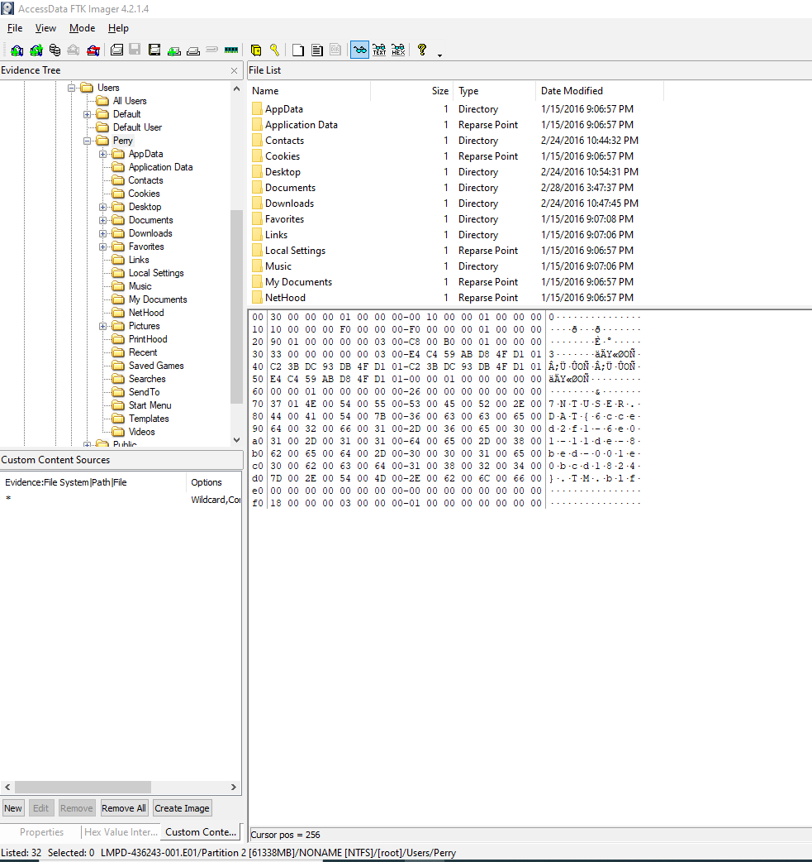
User “Perry” using FTK Imager

Slide 6
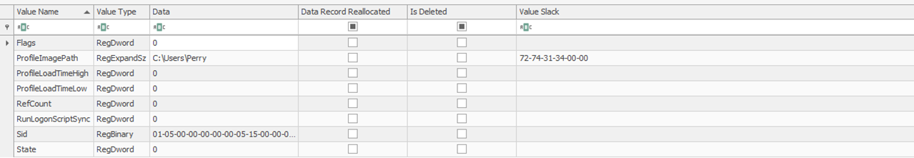
User Perry in Registry Explorer

Slide 7
Autopsy System Information

Slide 8
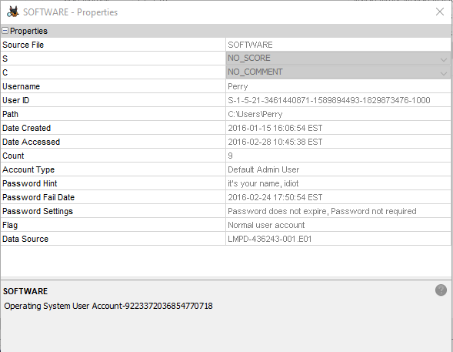
Autopsy SYSTEM HIVE

Slide 9
Question 2:
Is there any evidence on the computer that the user may have been associated with drugs or other illegal activities?

Slide 10
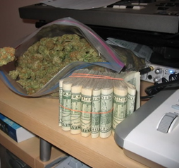
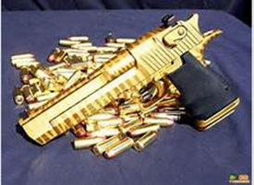
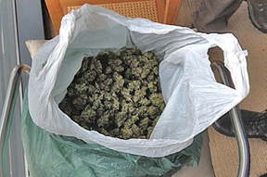
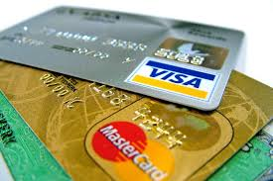
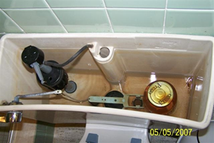
Evidence found on the hard drive

Slide 11
Question 3:
Is there any evidence that the user may have been trying to cover their tracks or delete evidence from the computer?

Slide 12
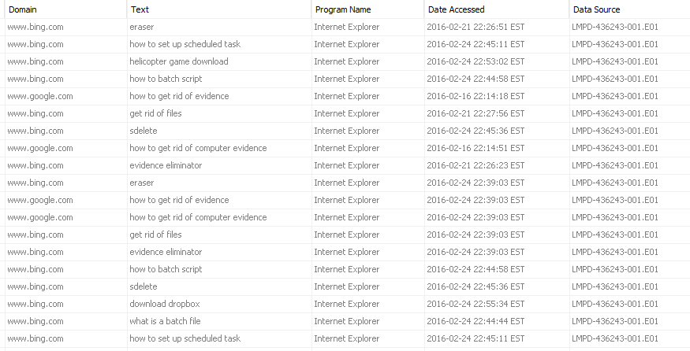
Web Searches found in Autopsy

Slide 13
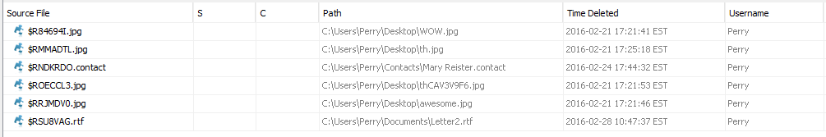
Deleted Files in Recycling Bin

Slide 14
Question 4:
Can you identify any additional items (such as USB devices) that may contain pertinent evidence? If so, what are they? Include as much identifying information about each device as possible.

Slide 15
USB Devices Found
The Kingston USB Device is the device that contains the Car1 and Car2 file.
The SanDisk USB Device is the device that contains the picture of mike’s desk

Slide 16
Question 5:
Is there any evidence on the computer that the user may have been planning to go on the run? If so, can you determine where the user was planning to go? a. If the user was planning to run, is there evidence that anyone might be traveling with them? If so, can you determine the identity of the accomplice(s)?

Slide 17
There was evidence that they were on the run
Looking at TypedURL in the NTUSER.DAT hive using registry explorer, a recent website URL visited was http://southwest.com/. This would suggest he was planning on flying somewhere.
We found an email from Pery to Rick saying that he is in the lobby of a hotel. The IP address of the associated with the email came from Brazil.
Using autopsy we found evidence that an email was sent to Rick, whom he is traveling with. Perry discusses that he will be wiring Rick money so that he can get on a flight and meet up with him.

Slide 18
Question 6:
What other evidence did you locate on the computer that may assist LMPD in its investigation (e.g. files that point to additional leads, accomplices, or any other activity not targeted by the initial investigation)?

Slide 19
Other Useful Info for LMPD
We found a file under \Users\Perry\Documents\emails that is zipped named “plan.zip” that has been corrupted. We feel this might entail their whole plan to leave the country and their next step.
We also think that the contacts Mary Reister and Larry Spitz are suspicious. We definitely believe they were connected and probably know information about Perry.
Another red flag was the downloading of the TOR browser. That is linked to the dark web so we feel some suspicious activity might have been going on in the dark web that has to do with Perry.

